Slide 1


NSF Large Facilities Cyberinfrastructure Workshop
OAC Update
Irene Qualters, Director
Office of Advanced Cyberinfrastructure (OAC)
September 7, 2017
Notes:
Thank you for coming. We’ll start our presentation shortly.
When you were here last year – about a month into this job; now a year into this job. What a privilege and honor to serve as NSF CISE AD. Assembled here around us, CISE leadership – they’re collectively an amazing and dedicated group of people, what an amazing group to work with; they are a “pocket of awesomeness” (to steal a phrase from Megan Smith our CTO).
Go around room.

Slide 2
Outline
National Context
CI as Research Infrastructure
OAC Looking Forward

Slide 3
Trends in Academic R&D Funding of Science and Engineering

Slide 5
NSF view of Science and Engineering Frontiers is Multidisciplinary

Slide 6
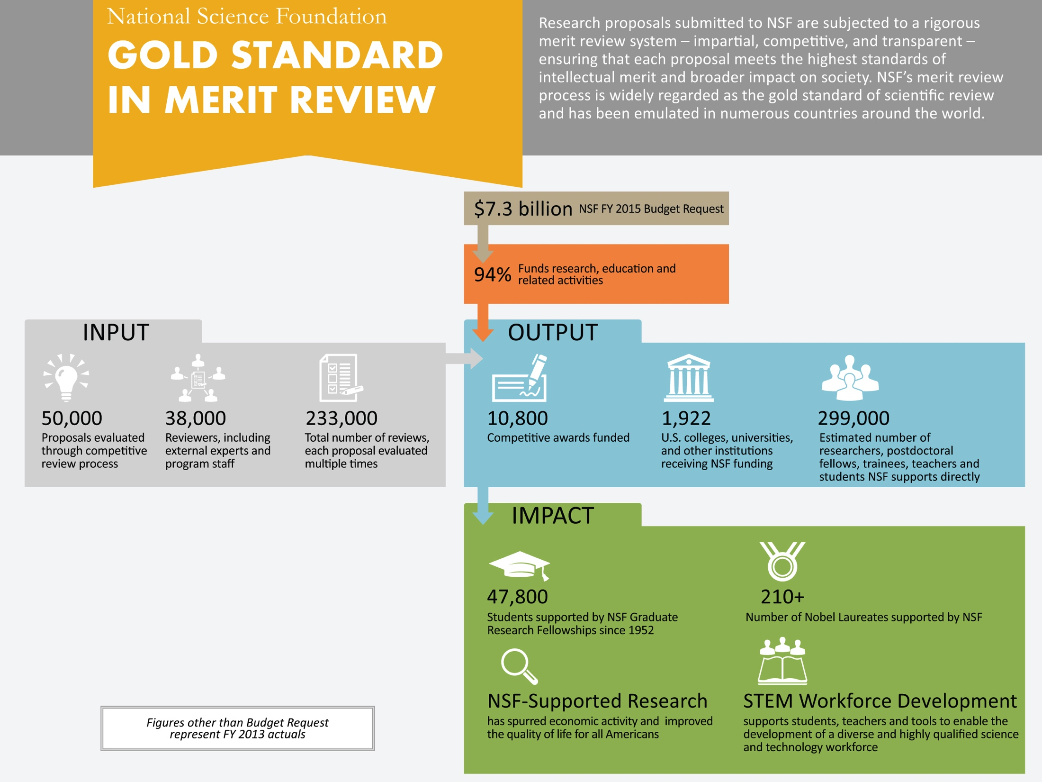

Data Current as of 2014

Slide 7

FY 2018 Budget Request
NSF
FY 2018 Budget Request: $6,653 M Comparison to FY 2016 Actual: -$841 M, -11.2%
CISE
FY 2018 Budget Request: $839 M
Comparison to FY 2016 Actual: -$96 M, -10.3%
Notes:
Budget Request for NSF and CISE
This is the beginning of the FY18 budget process – it is the President’s prosed budget and the actual budget is appropriated by Congress.

Slide 8




FY 2018 Budget Request for CISE
Notes:
Budget Request for CISE divisions
Compared to FY2016 actuals

Slide 9
Principles Underlying the Budget Request for CISE
Honor ongoing commitments (existing awards).
Investments in core research programs are maintained.
Investments across the breadth of the research cyberinfrastructure ecosystem continue.
Commitment to national priorities continue.
CISE remains committed to building and nurturing partnerships.
Notes:
In times of constrained resources, budget request is shaped by guiding principles. We have to the extent possible,

Slide 10
Outline
NSF in the National Context
CI as Research Infrastructure
OAC Looking Forward

Slide 11
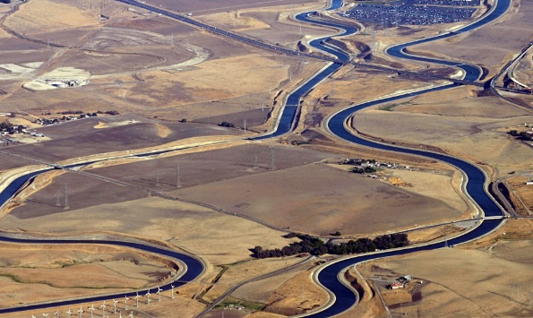
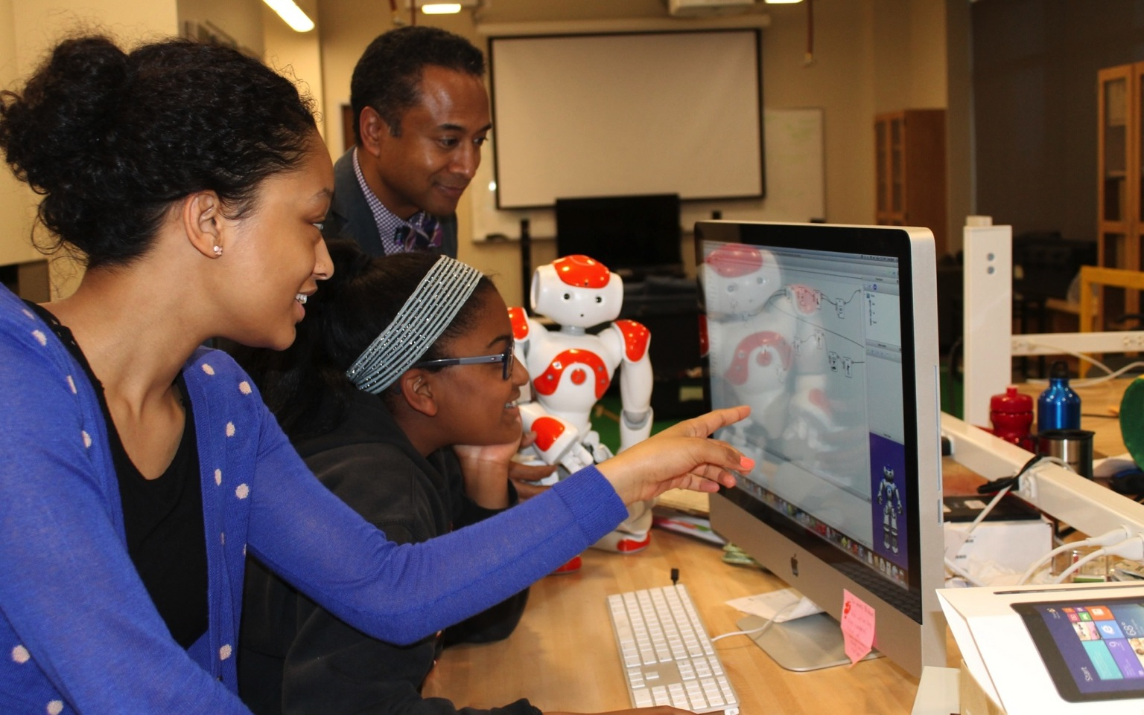
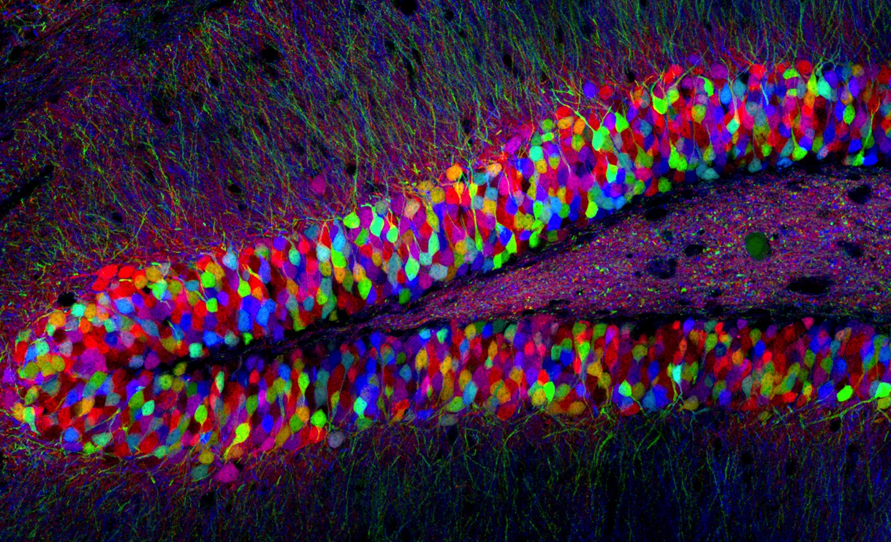
NSF Addresses National Priorities through Support of Fundamental Research
Food/Energy/Water
INCLUDES
Understanding the Brain
…..and this requires a highly capable, highly interoperable Research Infrastructure both human and technical.

Slide 12

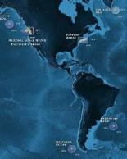
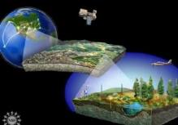


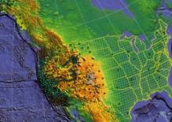
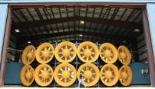
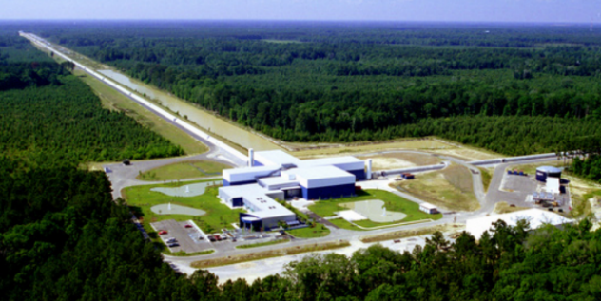
Facilities are Increasingly CI Intensive … and dependent on robust, reliable, and highly connective CI

Slide 13


NSF embraces an expansive view of Cyberinfrastructure driven by research priorities and scientific process
Scientific
Instruments
EXPERIMENT
ANALYZE
THEORIZE
HYPOTHESIZE
OBSERVE
Computational
Resources
Scientific Discovery & Innovation
Software
Networking &
Cybersecurity
People, organizations,
& communities
Data

Slide 14

CIF21 Initiative Sunsets in 2017

Slide 15

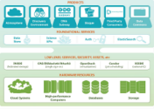






NSF’s CIF21 fostered a rich NSF cyberinfrastructure ecosystem responsive to the evolving discovery process.
Cloud Resources & Services
CI-Enabled
Instrumentation
Computing
Resources
Data Infrastructure
Gateways, Hubs,
and Services
R&E Networks,
Security Layers
Coordination
& User support
Software and
Workflow Systems
Pilots,
Testbeds
People, organizations,
and communities
Many parts! … Working together? … The right architectures? …
… Bottlenecks? … New pressures? …. Gaps?

Slide 16
Outline
NSF in the National Context
CI as Research Infrastructure
Looking Forward

Slide 17

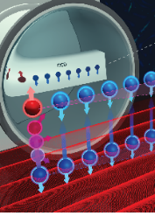

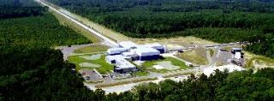

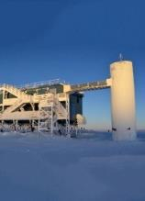






NSF “Big Ideas” – each have demanding CI implications
RESEARCH IDEAS
Work at the
Human-Technology
Frontier: Shaping the Future
Windows on the Universe:
The Era of Multi-messenger Astrophysics
The Quantum Leap:
Leading the Next Quantum Revolution
Navigating the
New Arctic
Understanding the Rules of Life:
Predicting Phenotype
Harnessing Data for 21st Century Science and Engineering
PROCESS IDEAS
Mid-scale Research Infrastructure
NSF 2050: Seeding Innovation
Growing Convergent Research at NSF
NSF-INCLUDES: Enhancing Science and Engineering through Diversity

Slide 18








Dynamic discovery pathways at scale: Architecture view
Observation
Science
Portals
Applications,
Frameworks
Research
Facilities
Discipline-specific
Environments
…
Integrative Services
(“Middleware”)
Data Management
HPC access, community
OSG
Collaboration Platforms
Authentication
Workflow Systems
International
Private, commercial clouds
Campus, national resources
NSF-supported
resources
“Foundational”
CI Resources
National/International Research & Education Networks, Commercial Networks
Discovery

Slide 19
Actual architectures are more complex…and dynamic

Slide 20
Workshop White Papers: Beginning to Identify Common CI Pathways for Acceleration of Discovery?

Slide 21

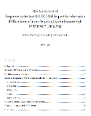
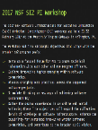
Community input is informing NSF’s strategic planning for Advanced CI
NSF Advisory Committee for Advanced Cyberinfrastructure (ACCI)
National Academies report on NSF Advanced Computing (2016): - Future Directions of NSF Advanced Computational Infrastructure to Support US Science in 2017 – 2022
NSF RFI on Future Needs for Advanced Cyberinfrastructure to Support Science and Engineering Research (NSF CI 2030), (2017)
Joint agency assessment of the NSCI Exascale RFI (2015): - NSF Assessment of Responses to the Request for Information (RFI) on Science Drivers Requiring Capable Exascale High Performance Computing
Workshops and Reports, e.g.: - Software Infrastructure 2017 PI Workshop , - Building a Materials Data Infrastructure

Slide 22
NSF CI 2030 RFI Responses:
Analysis is underway with NSF Advisory Committee for CI (ACCI)
50% Single Author
366 Named Authors
136 Submissions
50% Groups (2-15 Authors)
(339 Unique)
(some were busy bees)
Geographic spread
39 States
9 Foreign contributors from 6 countries
https://www.nsf.gov/cise/oac/ci2030/rfi_responses.jsp

Slide 23

Represented Organizations
CI Resources
HPC Centers: NCSA, PSC, SDSC, TACC
Networks: Internet2, ESNet, NYSERNet, Great Plains Network
Academic Computing: Cornell, Iowa, Michigan, U Buffalo, U Tenn
Community Orgs and Societies
Coalition for Academic Scientific Computation (CASC)
Earth Science Information Partners (ESIP)
Illinois Natural History Survey
Intl Educational Data Mining Society
Midwest Big Data Hub
National Association of Marine Labs
National Data Service
NC Museum of Natural Sciences
NumFocus
UNOLS
EPSCOR/Idea
Consortium for Ocean Leadership (COL)
Plant Science Research Network
The Quilt
Univ Consortium for GIS (UCGIS)
Other agencies and their labs
DOE - ANL, LBNL
NASA - JPL, Space Tel Sci Inst
Navy, Naval Postgrad School (NPS)
NIST
NOAA, US Int OOS
USDA, Agricultural Research Service
USFWS
USGS
Research Institutes
Bigelow Lab for Ocean Sciences
Manylabs
Research Triangle Institute
Ronin Institute
Scripps Inst Ocean
Smithsonian
Companies
ESRI, Merck, Rangle.io, SRI, StormCenter Communication
NSF Facilities
Nearly all!
Next

Slide 24

Represented NSF Facilities
NSF Facility Contributors
ARF/UNOLS
Gemini
LHC
LIGO
LSST
NCAR
NHERI
NHMFL
NOAO
NRAO
NSO
RCRV
Mentioned
DKIST
Ice Cube
IODP
NEON
OOI

Slide 25
Disciplinary Coverage - Overview
Domain | Disciplines Represented in Responses | Proportion
Cyberinfrastructure | Cyber Ecosystem, Institutional, regional and national perspectives, cybersecurity, software | 31%
Math and Physical Sciences | Physics, Astronomy and Astrophysics, Mathematics, Materials Science, Chemistry (incl. Chem Engineering) | 21%
Life Sciences | Cellular, Organismal, Omics, Ecology, Environment, Evolution, Conservation, Plant Sciences, Health Sciences, Behavioral and Social Sciences | 19%
Geosciences | Oceans and Aquatic, Earth Science, Atmospheric and Climate Science | 14%
Engineering Research | Civil, Mechanical, Environmental, Nanotechnology | 6%
Computer Science | CS, Data Science, Open Data, Open Science | 6%
Education & Learning | Education Research, Science of Learning, Educational Data Mining, Learning Analytics, Technology in Education | 3%

Slide 26
RFI 2030 Themes Resonant with Large Facilities Cybersecurity Topics
Integrative Ecosystem
Robust, Secure, and Dynamic workflows and dataflows across diverse technologies and boundaries
Multi-institutional authentication for distributed communities
At-scale security approaches for research communities
Trustworthy Software and Data for Robust and Reliable Science
Emphasis on both Human and Technical Capabilities
Commitment to Continuity of CI and Research focus

Slide 27
Draft OAC Principles
Promote Science Excellence
Enable fundamentally new scientific advances
Attend to the current trends in research
Multidisciplinary, geo/institutionally-agnostic research and research teams
Complex problems; dynamic workflows; data-rich
Robust and reliable science
Focus on Unique NSF contributions to CI support for Research
Holistic view:
Build capability, capacity, and cohesiveness of national CI Ecosystem
Consider both human and technical aspects of CI
“Lean forward” to new approaches and technologies
Act as a model steward
Encourage reuse of investments in CI
from industry, federal agencies, academic institutions, etc.
Foster partnerships and community development
Incent measurement and sharing of results

Slide 28
Thank you

Slide 29
NAS Report on Future NSF HPC Summary of Recommendations
Leadership
Grow comprehensive investments in advanced computing.
Support full range of science requirements for advanced computing.
Collect community requirements; develop roadmaps to inform decisions and set priorities.
Adopt approaches to consider investments in an integrated way with associated research.
Software. Support development and maintenance of expertise, scientific software, and software tools relevant to advanced computing resources.
Next-generation capabilities. Make modest in next-gen hardware, software technologies to explore new ideas for next-gen capabilities. Adoption of radical new technology takes time.
Manage advanced computing investments in a predictable and sustainable way.
Meeting Needs
On the Cutting Edge
Sustainability
Report: www.nap.edu/catalog/21886

